Slide 1
Progress on Work Packages
Model Writer

Slide 2
WP1 - Industrial use case and requirements
Anne MONCEAUX
AIRBUS GROUP

Slide 3
WP1
To describe and define the industrial, real life Use Cases, their associated requirements and evaluation method.
Tasks:
T1.1 Evaluation Methods & Tools
T1.2 Industrial Use Cases for Belgium Consortium
T1.3 Industrial Use Cases for French Consortium
T1.4 Industrial Use Cases for Turkish Consortium
T1.5 Consolidated User Requirements and Review
T1.6 Consolidated Software Requirements and Review
T1.7 Annual Product Review
T1.8 Technical Risk Assessment

Slide 4
T.1.1 Evaluation Methods & Tools
UNIT, KOCSISTEM, AIRBUS, OBEO, HISBIM, MANTIS
To define evaluation methods, including the identification of metrics to quantify performance with and without ModelWriter
Status
Survey of available evaluation method and tools
D1.1.1 Evaluation Methods & Tools
Next:
Specification of use Cases KPI ; common KPI and selection of evaluation method and tools

Slide 5
T1.3 Industrial Use Cases for French Consortium
OBEO, AIRBUS
Status
Use case description
Discussed at 1st International ModelWriter Workshop in Izmir, Turkey
D1.3.1-Industrial Use cases for French consortium
Data collection
Part of the corpus data is provided by the partners.
Detailed description in D2.1.2 Documentation of the corpora
Public/private status
AIRBUS-OBEO-LORIA Non Disclosure Agreement finalized in June 2015
as some of the partners have not also decided for the privacy or publicity of the data, all of the corpus data is kept in a private repository in the GitHub
Remain to be done
Make public corpora available for all UC
Notes:
Use cases are illustrated by sample material (e.g. pieces of software or system lifecycle documents and/or models) resulting in Corpora

Slide 6
T1.4 Industrial Use Cases for Turkish Consortium
MANTIS + UNIT + KOCSISTEM + HISBIM
Status
Use cases description
D1.4.1 Industrial Use Cases for Turkish Consortium
Data collection
Part of the corpus data is provided by the partners.
However, some of the other partners have not decided on their corpus cases.
Public / private status
as some of the partners have not also decided for the privacy or publicity of the data, all of the corpus data is kept in a private repository in the GitHub
Notes:
Use cases are illustrated by sample material (e.g. pieces of software or system lifecycle documents and/or models) resulting in Corpora

Slide 7
T1.5 Consolidated User Requirements and Review
AIRBUS, OBEO, MANTIS, UNIT, KOCSISTEM, ALL
To share a common vision of User needs and expectations
Status
UC driven User requirements capture
Consolidation through collective review (2nd International ModelWriter Workshop in Brussels, Belgium)
User requirements are stored & managed in GitHub
D1.5.1 Minutes of the User Requirements Review meeting
D1.5.2 User Requirements Document (URD) was automatically generate from Github
Technical Risks based on the defined requirements are identified in D1.8.1 Technical Risk Assessment v1.0

Slide 8
T1.6 Consolidated Software Requirements and Review
AIRBUS, LORIA, UNIT, MANTIS, OBEO, KOCSISTEM, ALL
The [minimum] objective of the first year (Y1) is to integrate the key pieces of software together (modelling tools with a word processor within an IDE) to prove that we can have a unified prototype ModelWriter platform.
Status
Technical partners refined software requirements based on URD
Consolidation through collective review (2nd International ModelWriter Workshop in Brussels, Belgium)
Software requirements are stored & managed in GitHub
D1.6.1 Minutes of the Software Requirements Review meeting
D1.6.2 Software Requirements Document (SRD) was automatically generate from Github
See also D1.8.1 Technical Risk Assessment v1.0

Slide 9
T1.7 Annual Product Review
AIRBUS, Country coordinators – “Product review Committee”
TBD.
Status
TBD

Slide 10
T1.8 Technical Risk Assessment
OBEO, UNIT, KOCSISTEM + ALL
To identify, monitor and mitigate risks on the achievement of the project
Status
1st evaluation using Actuarial Approach of Technical Risk Assessment (TRA) of risks linked to requirements (URD, SDR) and technologies.
D1.8.1 Technical Risk Assessment v1.0
Next
The document may be up-dated throughout the project with special review at the same time as for the software requirements and the architectural design review, depending on the further details and requirements we get from the industrial use case providers.

Slide 11
WP2 - Semantic Parsing and Generation of Documents and Documents Components
Claire GARDENT, Mariem MAHFOUDH
CNRS / LORIA
Samuel CRUZ-LARA
University of Lorraine / LORIA

Slide 12


WP2
Goal: Provide tools and methods for:
Annotating text fragments with model elements
Converting texts to models and models to text
Tasks:
T2.1 Data Collection
T2.2 Semantic Parsing
T2.3 Natural Language Generation
T2.4 Definition of a common target semantic language
T2.5 Development of a Semantic Parser and of a Natural Language Generator

Slide 13

T2.1 Data Collection
AIRBUS (Confidential Data)
Text
System Installation Design Principles (SIDP) Documents
986 semi-structured SIDP rules
Models
The Rule ontology represents the SIDP rules concepts. An OWL ontology composed of 30 classes, 35 object properties and 54 data properties.
The Component ontology represents the concepts and the vocabulary used in system installation rules. It is an OWL-DL ontology and it is composed in its current version of 476 classes, 21 ObjectProperties and 35 DataProperties.
Non Disclosure Agreement finalised in June 2015.

Slide 14

T2.1 Data Collection
OBEO
Text
“TxStyle" Files: a set of files in natural language (i.e., English) related to the documentation of the application being modelled by Sirius
Models
Java Concepts: a list of Java identifiers (i.e., classes, interfaces, methods, etc.) related to Sirius
Ecore Concepts: a list of concepts related to Ecore (the Eclipse Modeling Framework meta model) and to Sirius

Slide 15
T2.2 Semantic Parsing
Developed a prototype illustrating the automatic construction of an RDFS KB from text (CNRS/LORIA)
« Parsing Text into RDF » B. Batouche, C. Gardent and A. Monceaux. SEPLN 2015, Alicante, Spain.
Full scale Implementation applied to AIRBUS SIDP rules (Airbus)

Slide 16
T2.3 Natural Language Generation
D2.2.1 Report: Overview and Comparison of Existing Generators
Keynote at SEPLN 2015, Alicante, Spain
2 Internships on generation from RDF data (ongoing)
Lexicalisation: automatic acquisition of a lexicon mapping RDF properties to natural language expressions
Document planning: automatic detection of typical document structures using DBPedia and Wikipedia

Slide 17

Semantic Annotation: Creating and Maintaining Synchronization Links, Checking their Consistency

Slide 18

ModelWriter Text & Model-Synchronized Document Engineering Platform
Creating synchronization links (relating text and model) Checking the consistency of created synchronization links
Maintaining synchronization links (create, search, delete, modify)

Slide 19
Creating Synchronization Links
Automatically
Exact matching: identified using String matching
Ex: Attach (text element) IsSameAs http://airbus-group/opd-function#Attach (ontology concept)
Morphological matching: identified using lemmatization and Stanford CoreNLP tools
Ex: Attached IsMorphologicallySimilarTo http://airbus-group/opd-function#Attach
Semantic matching: identified based on ontology and SKOS labels
Ex: Fixation isSynonymTo http://airbus-group.installsys/component#AttachmentPoint
Manually
UserLink: Created by the user

Slide 20
Checking the Consistency of Synchronization Links
Consistency check based on ontology's axioms and properties
Rule:
If a text element and an ontology concept are semantically disjoint, then they cannot be synchronized
Ex: rigid Component cannot be synchronized with http://airbus-group.installsys/component#FlexibleComponent

Slide 21
Maintaining Synchronization Links
Link maintenance operations:
Add New Link (user given)
Search Link (create or retrieve)
Remove Link
Synchronisation between text and links
RenameTextElement
Add TextElement
RemoveTextElement

Slide 22
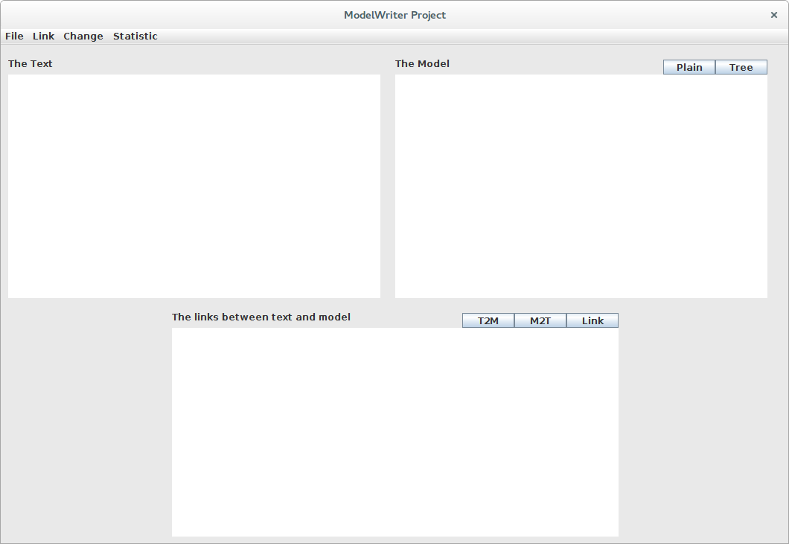
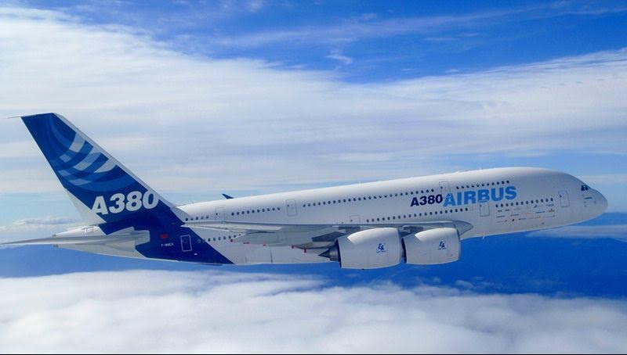
Semantic Annotation, Links Synchronization and Consistency Check
Application to Airbus Industrial Case

Slide 23
Semantic Annotation, Links Synchronization and Consistency Check
Semantic parsing and consistency check:
The prototype can be accessed on the GitHub Model Writer repository:
https://github.com/ModelWriter/WP2/tree/master/Tool

Slide 24

Semantic Annotation

Slide 25
Semantic Annotation
OBEO Corpora
EMF (Eclipse Modeling Framework)
The EMF project is a modeling framework and code generation facility for building tools and other applications based on a structured data model
From a model specification described in XMI, EMF provides tools and runtime support to produce a set of Java classes for the model, along with a set of adapter classes that enable viewing and command-based editing of the model, and a basic editor
SIRIUS
Is an Eclipse project based on EMF

Slide 26
Semantic Annotation
SIRIUS
A modeling workbench created with Sirius is composed of a set of Eclipse editors (diagrams, tables and trees) that allow the users to create, edit and visualize EMF models
The editors are defined by a model that defines the complete structure of the modeling workbench, its behavior and all the edition and navigation tools
For supporting specific need for customization, Sirius is extensible in many ways, notably by providing new kinds of representations, new query languages and by being able to call Java code to interact with Eclipse or any other system

Slide 27
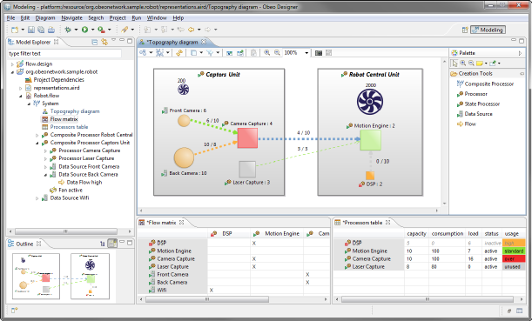
Semantic Annotation
SIRIUS

Slide 28
Semantic Annotation
OBEO Corpora
Java Concepts: a list of Java identifiers (i.e., classes, interfaces, methods, etc.) related to Sirius
Ecore Concepts: a list of concepts related to Ecore (the EMF meta model) and to Sirius
“TxStyle" Files: a set of files in natural language (i.e., English) related to the documentation of the application being modeled by Sirius

Slide 29

Semantic Annotation
A semantic annotator
We have developed is a basic prototype allowing to annotate the “TxStyle” files by establishing links to Java Concepts and to Ecore Concepts
Java Concepts
Model
Ecore Concepts
Annotated
TxStyle File
TxStyle File
Annotator
Document

Slide 30
Semantic Annotation
A semantic annotator
The prototype can be accessed on the GitHub Model Writer repository:
https://github.com/ModelWriter/WP6/tree/master/EcoreConcepts-JavaConcepts-Annotator

Slide 31
WP3 - Model to/from Knowledge Base Synchronization Mechanism
Moharram Challenger
UNIT

Slide 32
WP3
Objective: provide the synchronization mechanism to keep the “user-visible models” consistent with the “KB-stored models”
This will consist of the following main plug-in components:
Transformation Manager: provides the infrastructure to register and launch transformations.
Configuration Manager: for personalizing the behaviour of the framework to meet the needs of a specific standard / organization / project / individual.
Traceability Manager: keeps links between elements of user-visible models and elements of the KB.
Synchronization Manager: triggering transformations when synchronization is needed.

Slide 33
Tasks
T3.1 - Review of M2M transformation approaches
T3.2 - Specification and design of the M2M Transformation Framework
T3.3 – Development of the Transformation Manager component
T3.4 – Development of the Configuration Manager component
T3.5 – Development of the Traceability Manager component
T3.6 – Development of the Synchronization Manager component
T3.7 – Design of the model-to-model transformations
T3.8 – Implementation of the model-to-model transformations
T3.9 – Validation of the M2M Transformation Framework

Slide 34
T3.1 - Review of M2M transformation approaches
UNIT, KOCSISTEM
A systematic review of model-to-model transformation approaches, and a selection of the most convenient and widely used in the industry for inclusion into the ModelWriter tool
Status
Survey of available approaches and tools are available at:
D3.1.1Review of model-to-model transformation approaches and technologies
Next:
The document may be updated based on the new approaches and tools in SotA

Slide 35
T3.2 - Specification and design of the M2M Transformation Framework
UNIT + KOCSISTEM
Objective: Designing the M2M Transformation Framework whose main goal is to make the ModelWriter tool able to launch M2M transformations
Status:
D3.2.1 - M2M Transformation Framework architectural design document (incl. Transformation, Configuration, Traceability, and Synchronization architectural design)
Next:
The architecture may be updated based on the new needs during the project progress.

Slide 36
T3.2 - Specification and design of the M2M Transformation Framework
Overview of the components of the M2M Transformation Framework:

Slide 37
T3.3, T3.4, T3.5, T3.6 (UNIT + KOCSISTEM)
Development of the:
T3.3 Transformation Manager component
T3.4 Configuration Manager component
T3.5 Traceability Manager component
T3.6 Synchronization Manager component
Status:
These tasks has software deliverables which are developed and are available at GitHub
Next:
These components will be updated.

Slide 38
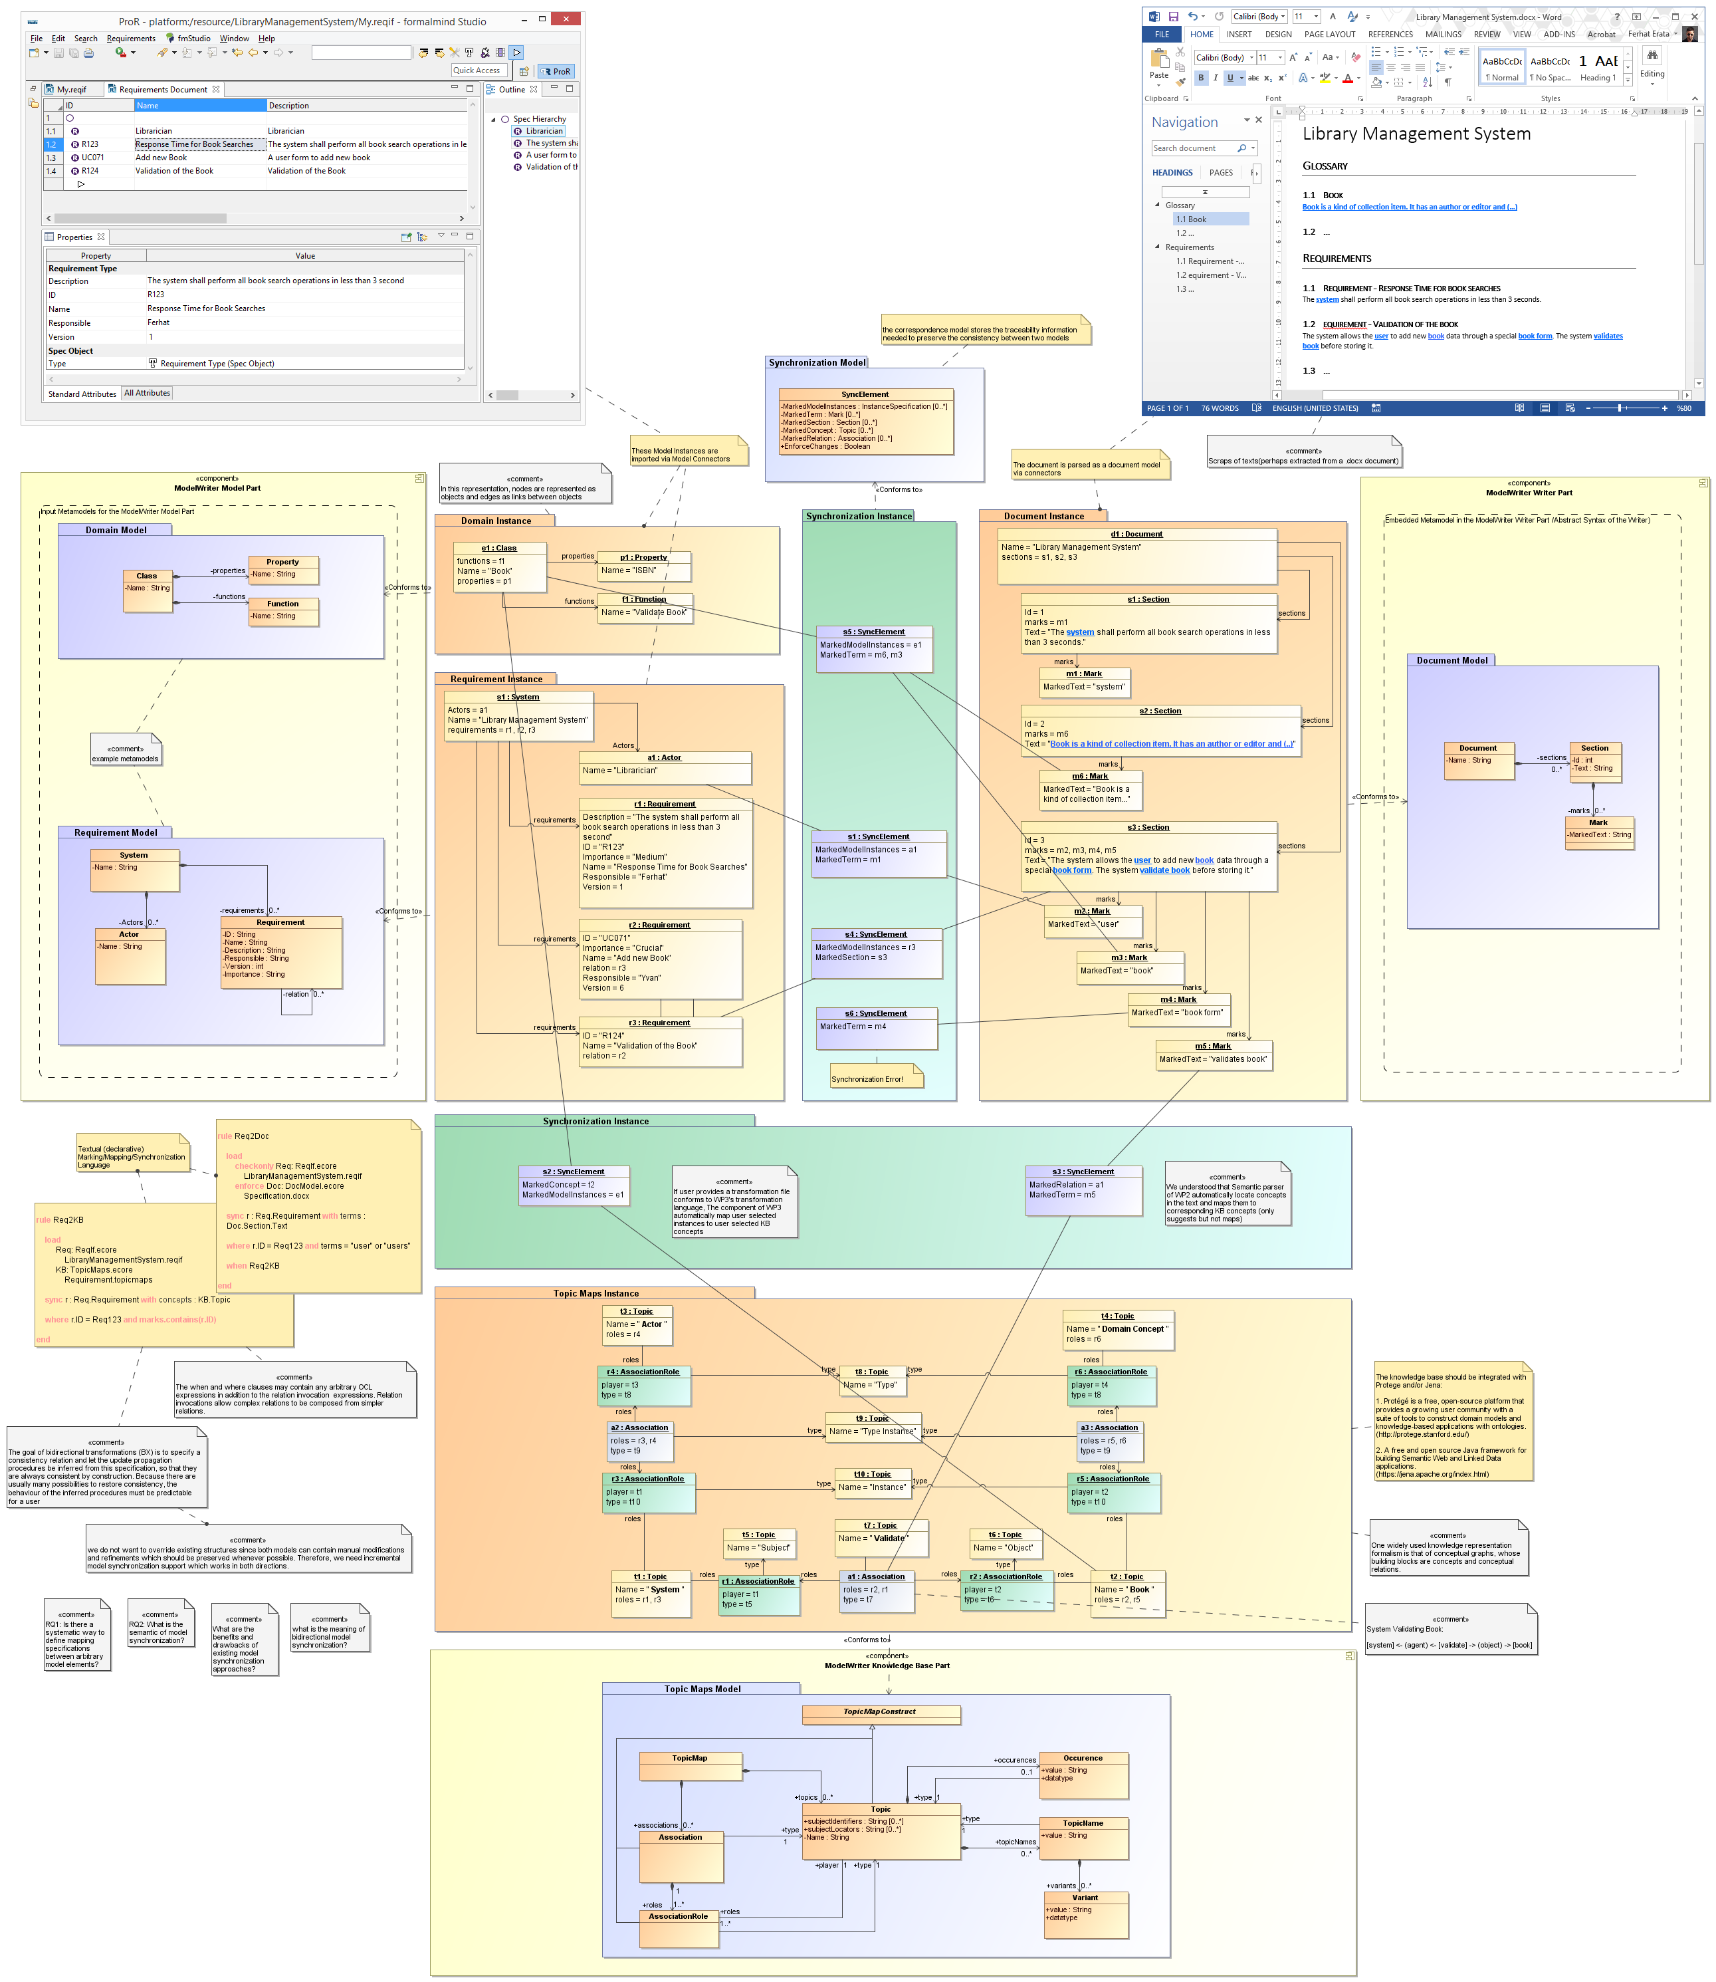
T3.3, T3.4, T3.5, T3.6 (UNIT + KOCSISTEM)

Slide 39
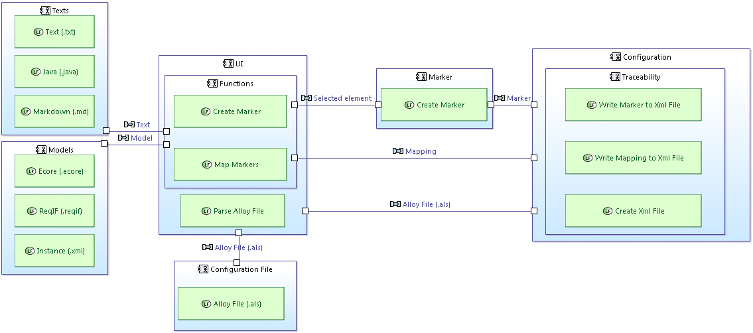
T3.3, T3.4, T3.5, T3.6 (UNIT + KOCSISTEM)

Slide 40
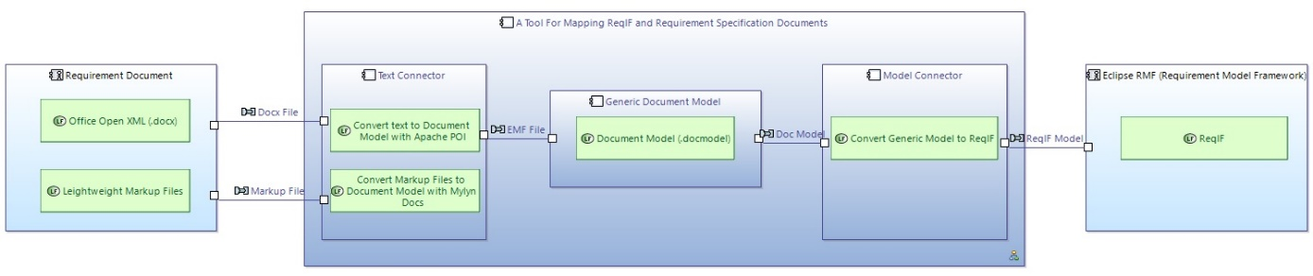
T3.3, T3.4, T3.5, T3.6 (UNIT + KOCSISTEM)

Slide 41
T3.3, T3.4, T3.5, T3.6 (UNIT + KOCSISTEM)
The fully functional demonstration of the main components of WP3 (T3.3, T3.4, T3.5, T3.6) will be presented at demonstration session.

Slide 42
WP4 – Knowledge base Design and Implementation
Prof. Dr. Erhan Mengusoglu
MANTIS

Slide 43
WP4 Knowledge Base Design and Implementation
Design and implement the ModelWriter’s federated Knowledge Base itself, hosting multiple formalisms.
Design and implement its bi-directional text-model synchronization mechanism.
Design and implement its API.
Design and implement a set of specialised modules (plug-ins) that exploit the Knowledge Base in ways that make the tasks of Technical Authors much more productive, e.g. consistency checks.
Design and implement the collaborative functions linking and hierarchically organizing multiple ModelWriter KBs used by different Technical Authors on different sites.

Slide 44
WP4 Knowledge Base Design and Implementation
Plug-in #1 – This provides consistency and completeness checks within the same software lifecycle document, allowing automatic quality review of the content (meaning).
Plug-in #2 – This provides consistency and completeness checks between related set of documents.
Plug-in #3 – This provides semantic comparison between two versions of the same software lifecycle document (i.e. what conceptual changes have happened).

Slide 45
WP4 Knowledge Base Design and Implementation
T4.1 - Design of the Knowledge Base (MANTIS + OBEO + KUL2 + UNIT + KOCSISTEM)
T4.2 - API of the Knowledge Base (KOCSISTEM + KUL2 + + OBEO + UNIT + HISBIM)
T4.3 - Implementation of the Knowledge Base (KUL2 + MANTIS + HISBIM)
T4.4 – Plug-in #1: ModelWriter-assisted requirements review (KUL2 + MANTIS)
T4.5 – Knowledge Base serialization and reuse plug-in (MANTIS)
T4.6 – Plug-in #3: ModelWriter-assisted semantic comparison of 2 documents (OBEO + MANTIS + HISBIM)
T4.7 – Plug-in #2: ModelWriter-assisted compliance review (MANTIS + UNIT + AIRBUS +SOGETI)
T4.8 – Internal bi-directional synchronization mechanism (OBEO + UNIT)
T4.9 – External synchronization mechanism for collaborating ModelWriters (HISBIM)

Slide 46
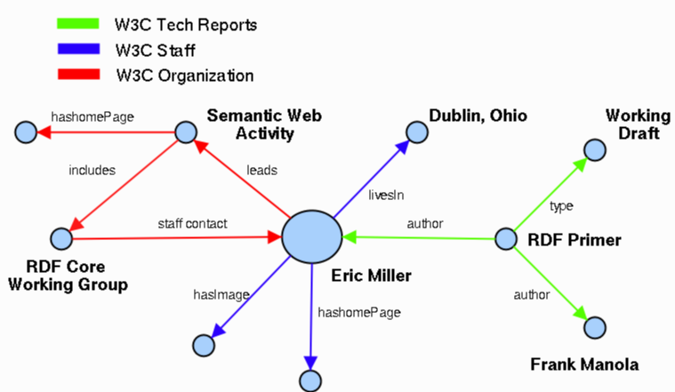
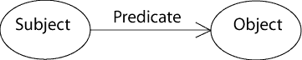
WP4 - T4.1 – Design of the Knowledge Base
Semantic Web
RDF Expression

Slide 47
WP5 – Project Management
UNIT Information Technologies Ltd.

Slide 48
WP5
Objectives:
To perform overall project governance, and to establish and maintain a communication and controlling infrastructure to run the project smoothly.
Status:
Project Coordination Committee (PCC) and Technical Coordination Committee (TCC) are constituted.
Collaboration mechanism is stablished
Development management environment is created
Next:
The 1st release will be issued

Slide 49
WP5
T5.1 – Communication Management and Collaboration Infrastructure (UNIT + WP7 leader)
T5.2 – Project Coordination and Reporting (UNIT + Country Coordinators + WP Leaders)
T5.3 – Project Controls (UNIT + WP Leaders)
T5.4 – Closing Project (UNIT + WP Leaders)

Slide 50
T5.1 Communication Management and Infrastructure
Mailing lists: @modelwriter.eu
Source Code Management: GitHub.com/modelwriter
Project Co-authoring and document management: Google doc and GitHub
Scrum Management: Waffle and GitHub
Issue and Bug Tracking, etc: GitHub

Slide 51
T5.2 Project Coordination and Reporting
Yearly ITEA review meetings
National review meetings (e.g. in every 6 month in Turkey)
International workshops: face to face meetings (in each 3 months)
Monthly International Telco meetings
Weekly collaboration meeting: e.g. UNIT-KS
Action specific meetings: e.g. Airbus-UNIT action

Slide 52
T5.3 – Project Controls
Monitoring the deliverables
Monitoring the requirements
Decision mechanism for addressing issues, changes, risks
Progress controls by means of
monitoring,
regular meetings and
reports such as
Kick-off and closing report
Project management plan
Yearly ITEA PPR
National progress reports

Slide 53
WP6 – Architecture, Integration and Evaluation
Yvan lussaud
OBEO

Slide 54
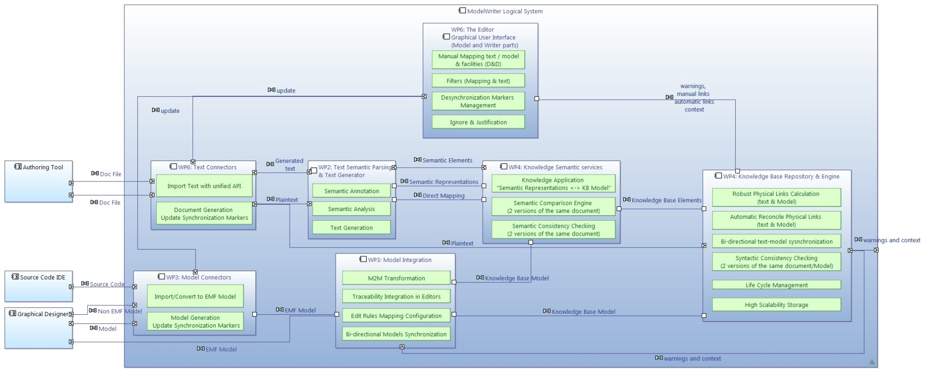
WP6 ModelWriter Functional Architecture

Slide 55
WP6 Text connectors

Slide 56
WP6 Model connectors

Slide 57
WP6 Text semantic parsing and text generator

Slide 58
WP6 Model Integration

Slide 59
WP6 Knowledge Semantic services

Slide 60
WP6 Knowledge base repository and engine

Slide 61
WP6 Editors and GUI (Model and Writer parts)

Slide 62
WP6 Integration
Source code
Github repository
Checkstyle and code templates
Target platforms
Continuous integration
Next steps
Jenkins
Provide an update site and an Eclipse product
integrate existing components
Ease the release process

Slide 63
WP6 Evaluation
Unit testing
JUnit
Code coverage (Eclemma)
Integration testing
Use cases
Jenkins will run all tests on a daily basis
Functional testing via GUI (RCPTT)
Milestone functional testing
Drives features and enhancements

Slide 64
WP7 – Standardization, Dissemination and Exploitation
Yvan lussaud
OBEO

Slide 65
WP7 Standardization
Specification and verification of ALM platform
Change impact analysis and visualization
System installation component ontology
Semantic annotator
Synchronization engine prototype
Open source software - traceability
Open source software – relational calculus
De facto standard – Airbus vocabulary
Open source software – API for text annotation
Open source software – Eclipse Intent contribution

Slide 66
WP7 Dissemination
International ModelWriter workshops
Parsing text into RDF
5th Turkish software Architecture conference
5 workshops – 2 open workshops
2 Keynotes on text generation at SEPLN 2015
Keynote speech at International Workshop on Advanced Topic in Software engineering
Publication poster – propose a RDF-based method for querying the content of a text
Develop an open source community for model and text synchronization
Spanish Natural Language Processing Conference – academics and industrials – a project session
Present Eclipse ecosystem and Modeling approach to software engineering

Slide 67
WP7 Exploitation
Requirement documents and ReqIF standard synchronization
CSV to OWL transformation
SIDP installation rule model
Collaboration between UNIT and HAVELSAN
Traceability in ALM platform – applied to Microsoft Team Foundation Server – support of KoçSistem
Prototype – automatic synchronization between ReqIf models and requirement documentation
Generates a triple dataset to populate the SIDP (System Installation Design Principle) rule model
Model of SIDP installation rules using RDFS and OWL languages

Slide 68
WP7 Exploitation
Enhancement in text connector for Airbus
Collaboration/Participation of FORD-Otosan
Collaboration between Obeo and Airbus
Expertise on document extraction
Syntactical parsing of SIDP rules based on templates
Long term support – semantic parsing and traceability for Product Life Cycle documents
Discussions on topics related to the ModelWriter scope
Improve expertise on information extraction for reverse engineering purpose

Slide 69
Thank you for your attention! Any question ?

